Slide 1

Climate Change
Group 10

Slide 2

Our Goal
By this presentation, we aim to give the audiences a basic but broad understanding about the big topic of Climate Change
The takeaway of this presentation would include:
How the public think about Climate Change
The consequences of Global Warming
The possible cause of it
Some suggestion

Slide 3

INDEX PAGE
Public Opinion
Temperature and Disasters
Emission Study
Data Cleaning and Grouping
Summary and Visualization
Predictive Analytics
Conclusion and Recommendation

Slide 4
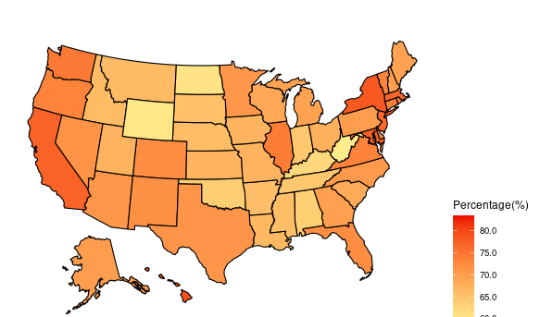
Public Opinion
By 2020, 72% of American believe that global warming is happening
Most Americans realized the global warming/climate change.
It looks good, but wait…
Data from Yale’s American Mind project
Notes:
According to a large national survey dataset (>25,000 respondents) collected between 2008 through 2020 as part of the Climate Change in the American Mind project
Data source:
https://climatecommunication.yale.edu/visualizations-data/ycom-us/

Slide 5
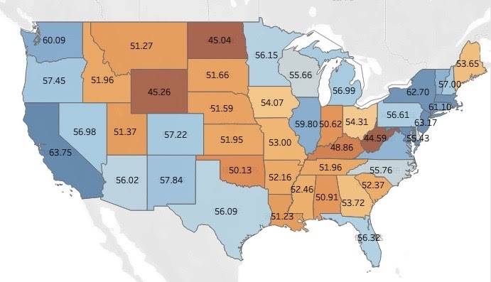
Public Opinion
Only 57% of American believe that climate change is caused mostly by human activities
Less people in middle part of the U.S. agree with the statement. Most of them are agriculture states
This is why we are doing this presentation. Now, let’s check some facts
Data from Yale’s American Mind project

Slide 6

Temperature and Disasters

Slide 7
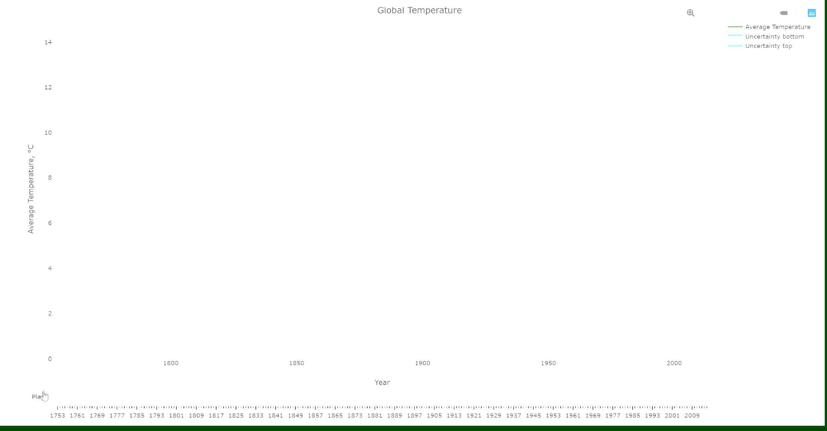
Data from Berkeley Earth

Slide 8
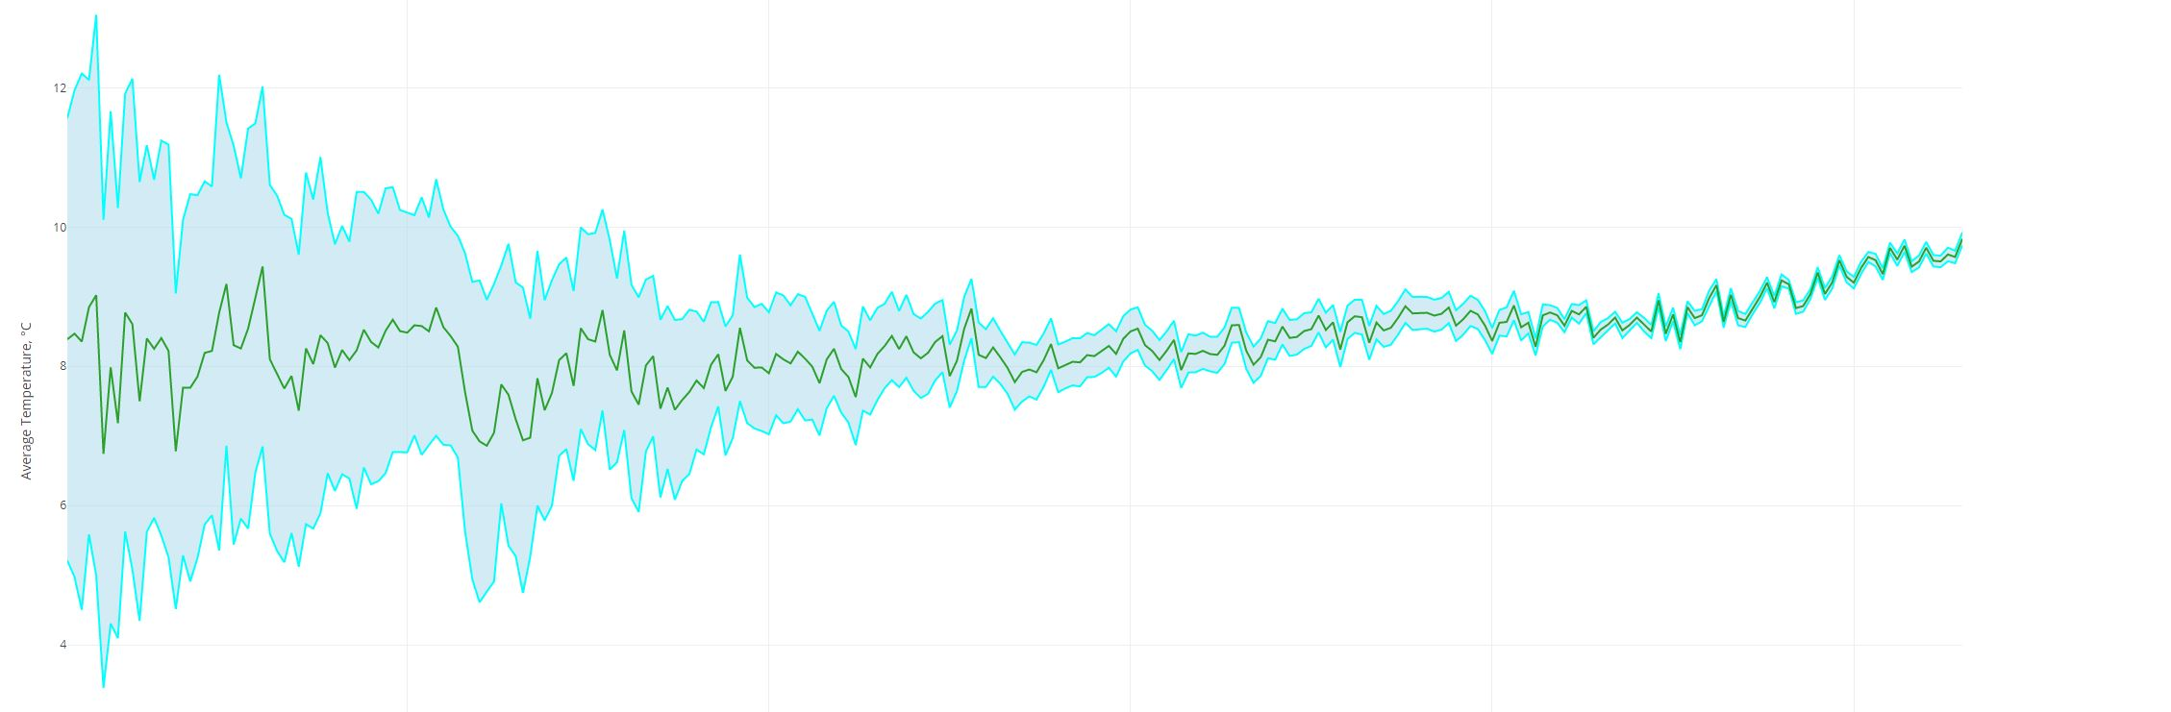
Global Temperature Trend
2015
1940
1880
We can see there is a trend of global temperature rising after the second Industrial Revolution, and the trend got steeper since the end of World War II During this period, three major changes happened:
Massive use of fossil fuel
The Population Explosion
The Globalized Industrialization
What did earth respond to this global warming?
Data from Berkeley Earth

Slide 9
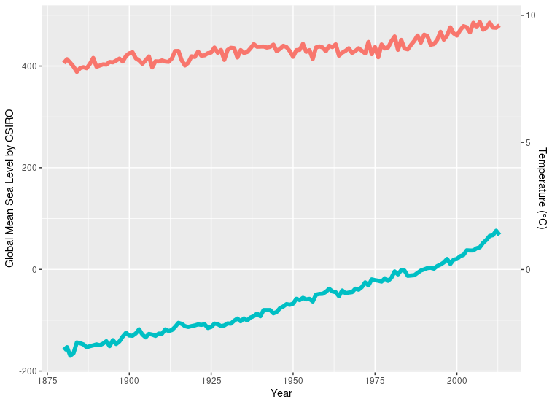
Temperature and Disasters
Since 1880, the global mean sea level has raised about 241.55 mm
146.8
Through 1940 to, the global mean sea level has raised by 146.8 mm
This could mainly be related to melting inner-land glaciers
Data from Commonwealth Scientific and Industrial Research org
Notes:
Data source: https://datahub.io/core/sea-level-rise#resource-csiro_recons_gmsl_mo_2015
GMSL: Global Mean Sea Level in mm

Slide 10
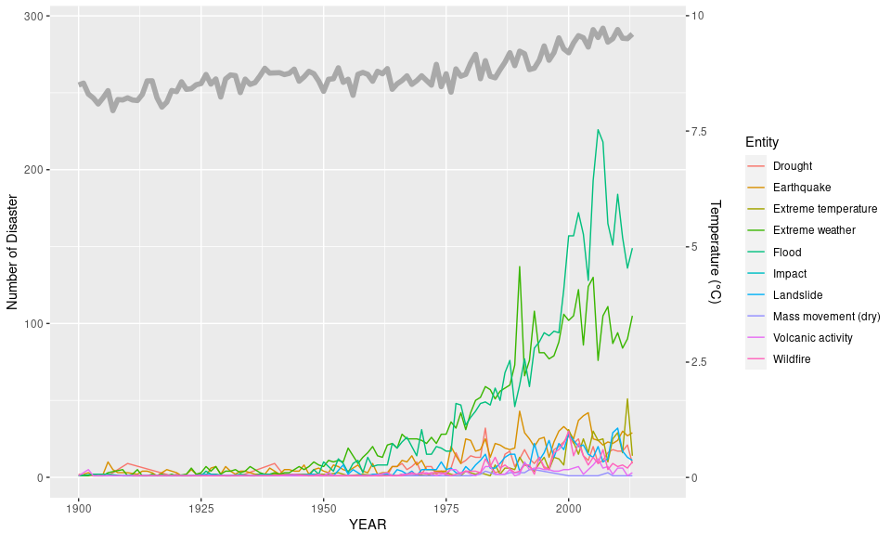
Temperature and Disasters
Through 1940 to 2018, the frequency of almost every kinds of natural disasters had increased
Among them, flood and extreme weather changing are the most noticeable
Data from OFDA/CRED International Disaster Database
Notes:
Data source: https://www.kaggle.com/dataenergy/natural-disaster-data and https://ourworldindata.org/natural-disasters

Slide 11
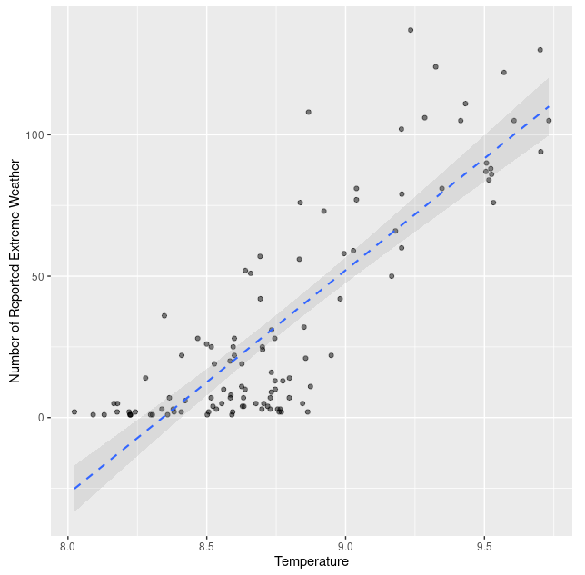
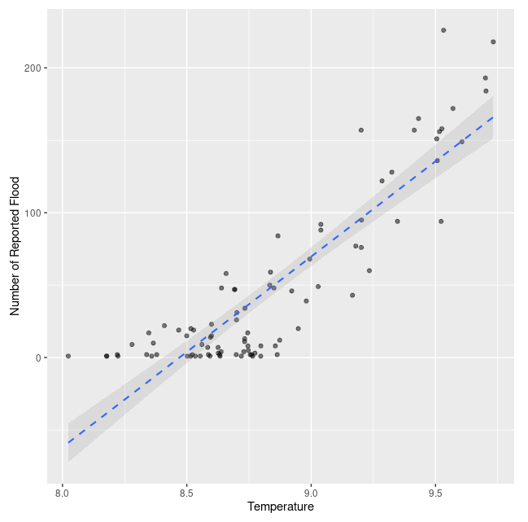
Temperature and Disasters
The scatter plots shows:
Both flood and extreme weather are positively related to temperature
What change can we make to cool the earth down?
(or at least slow the warming)
Notes:
We can see clear linear relationship between Flood (or Extreme Weather) and Temperature. The increasing of disasters number is very sensitive to increasing in temperature change.

Slide 12

Emission Study

Slide 13
Our Dataset is a Combination of Two
The PRIMAP-hist national historical emissions time series (1850 – 2017)
Source Organization: Postdam Institute For Climate Impact Research
The GHG emission data was draw from this dataset
The Global Temperatures dataset (1750 – 2015)
Source Organization: Berkeley Earth
The global average temperature data was draw from this dataset

Slide 14
Data Cleaning and Grouping
Using R dyplr package to inner join the datasets by year (1850 - 2015)
Data Cleaning
In global temperatures dataset, only use removed 12 NA values, convert monthly temperatures to annual average temperatures using group_by
In PRIMAP-hist national historical emissions time series, removed non-relevant texts
Data Structure:
After cleaning, the data structure is 166 * 18; Before cleaning, 3192 * 25
Data Type:
Integers and Numeric, and Date type

Slide 15
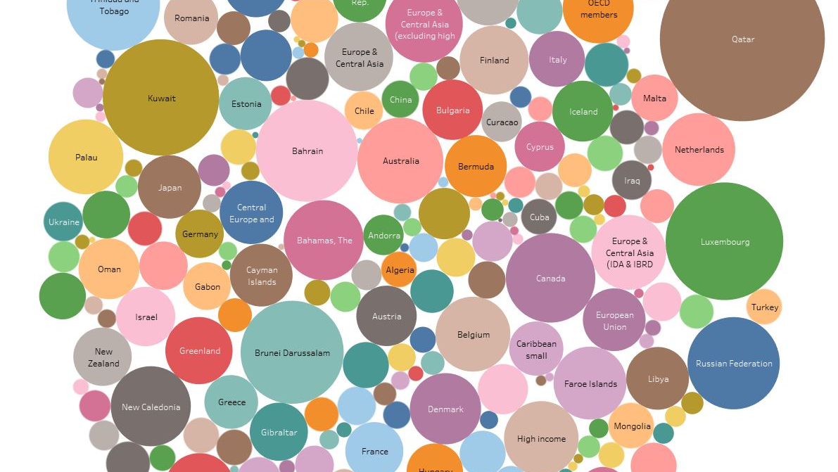
Visualization
Notes:
Tableau public link: https://public.tableau.com/views/CO2perCapDashboard/CO2percapdashboard?:language=en&:display_count=y&publish=yes&:origin=viz_share_link

Slide 16
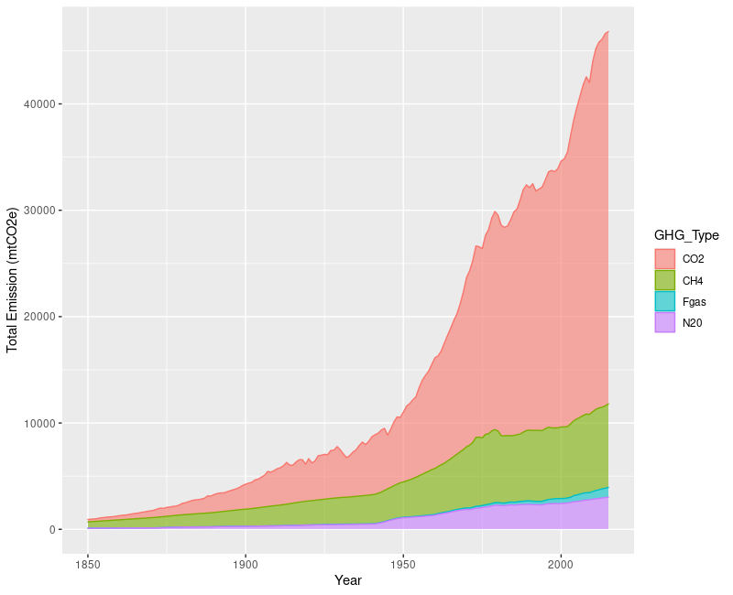
GHG Emission by Year
The emission of all four kinds of the green house gases are increasing year by year
The increments are all significant
CO2 has the biggest jump

Slide 17
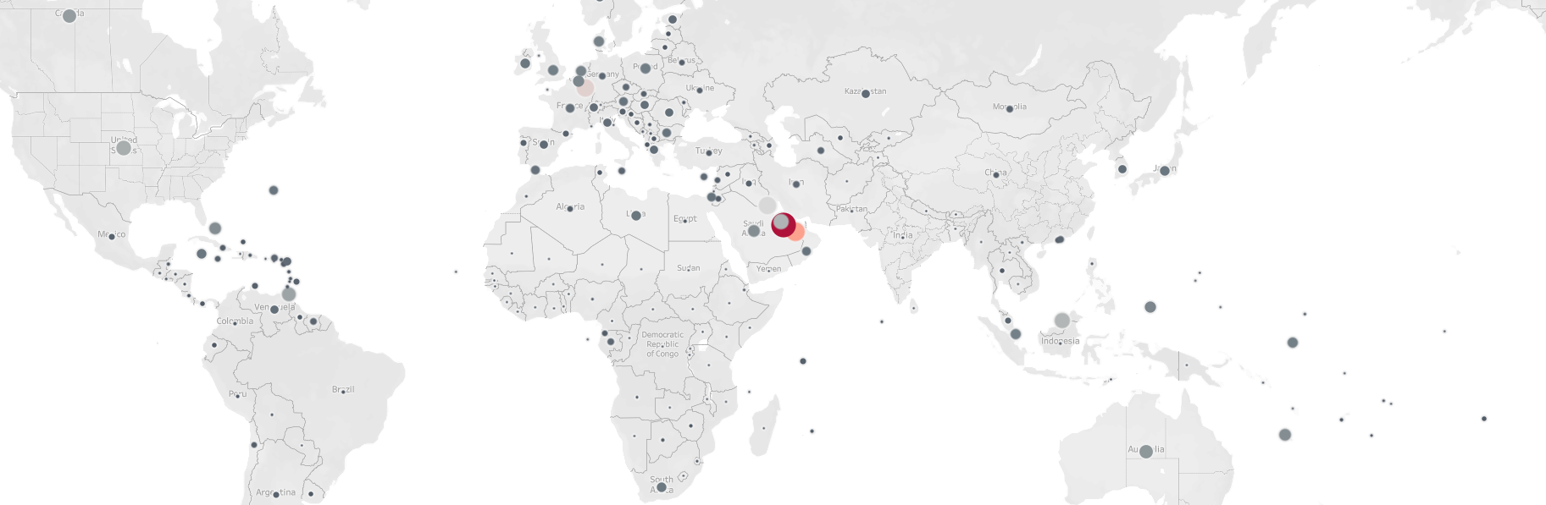
Map Visualization
Both the size and the color shows the cumulated CO2 emission per capita
Petroleum exporting countries and developed countries have higher CO2 emission per capita
Notes:
The per capita visualization used the population number from the world bank
Tableau public link: https://public.tableau.com/views/CO2perCapDashboard/CO2percapdashboard?:language=en&:display_count=y&publish=yes&:origin=viz_share_link

Slide 18
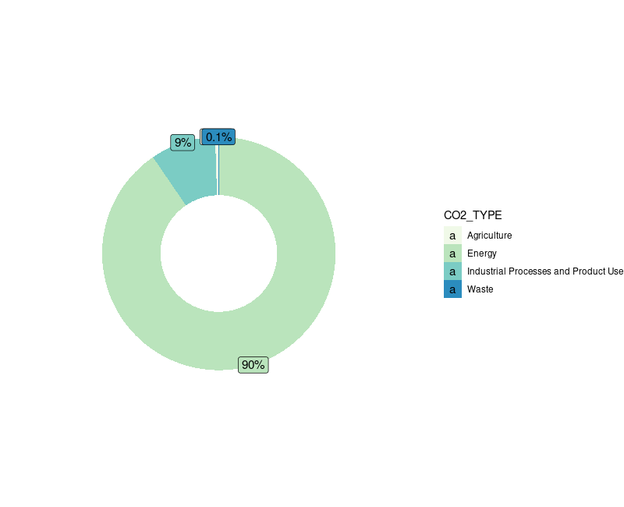
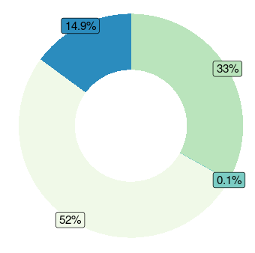
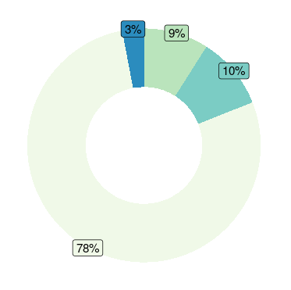
Greenhouse Gases Origin
N20
Most of the CH4 and CO2 came from Agriculture sector
CH4
CO2

Slide 19
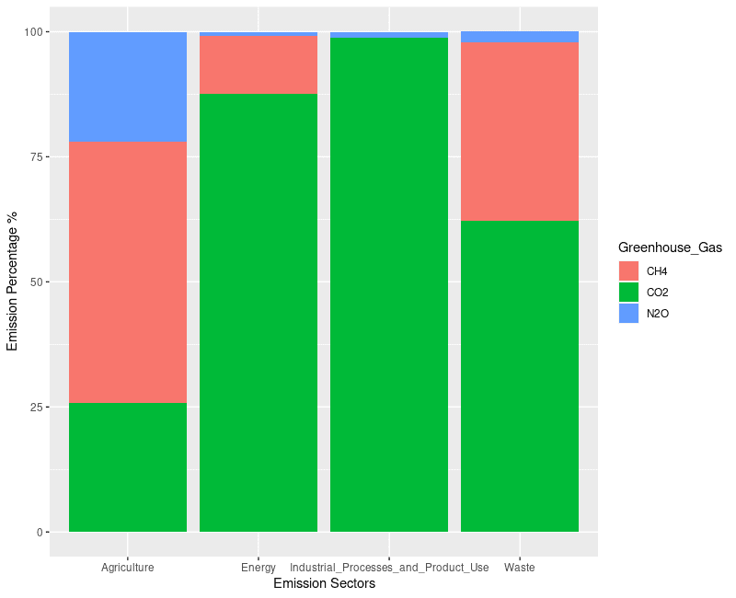
Sectors’ Emission
Agriculture sector produce balanced proportion of GHGs.
The Energy and Industrial Processes and Product Use sectors mostly produce CO2.
Waste sector produce CO2 and CH4 but not too much N2O

Slide 20
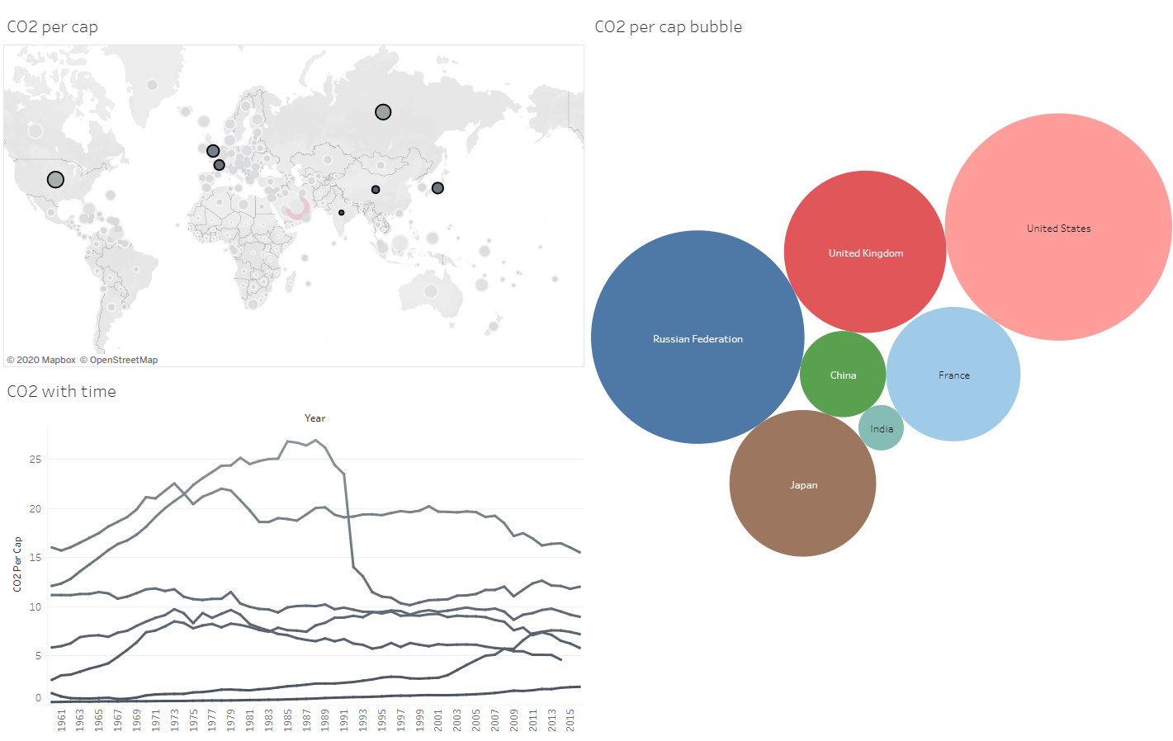
Predictive Analytics

Slide 21
Feature Engineering and Selection
We care about the increasing of global temperature, hence the predictive variable was set at “global average temperature”
We picked four most famous greenhouse gas (GHG) as the features:
Carbon Dioxide (CO2)
Methane (CH4)
Nitrous Oxide (N2O)
Fluorinated Gasses
Each of the GHG was categorized according to its origin:
Energy
Industrial Processes and Product Use
Agriculture
Waste

Slide 22

Model Design
5 Models:
Generalized Linear Model (glm)
Boosted Regression Model (glmboost)
Random Forest (rf)
Linear Least Squares (lm)
Stepwise Selection (glmStepAIC)
Apply 10-fold Cross-Validation on each of them to check:
Root Mean Square Error (RMSE)
R squared
Mean Absolute Error (MAE)

Slide 23

Comparison between Models
Models | Root Mean Square Error (RMSE) | R squared | Mean Absolute Error (MAE)
Generalized linear model | 0.1039126 | 0.8806361 | 0.08591636
Boosted regression model | 0.1257597 | 0.8308088 | 0.1027235
Random Forest | 0.09173089 | 0.9083568 | 0.07243502
Linear least squares | 0.1055907 | 0.8862334 | 0.08714464
Stepwise Selection | 0.1067489 | 0.8577271 | 0.08862704
Random Forest won all 3 sections

Slide 24
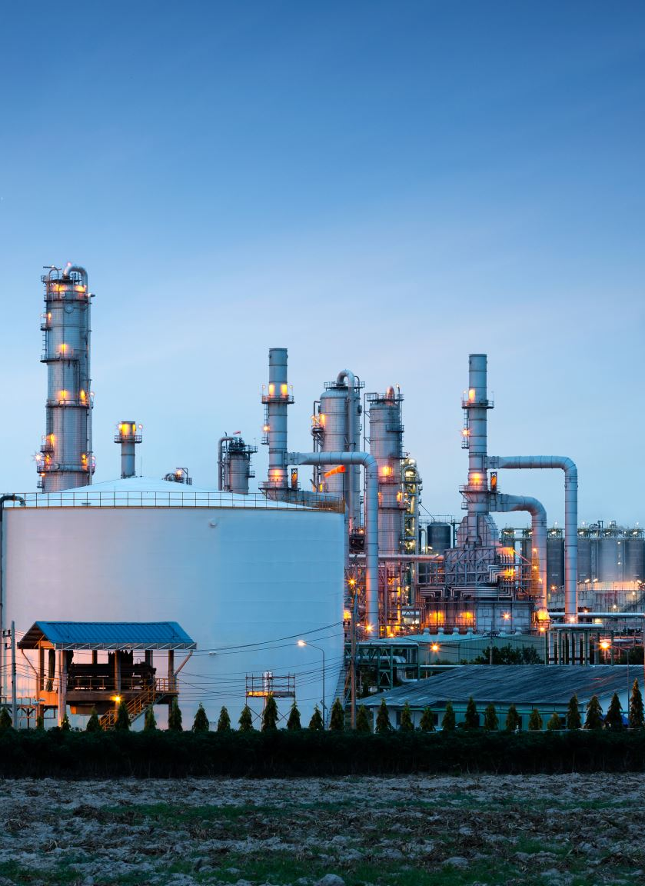
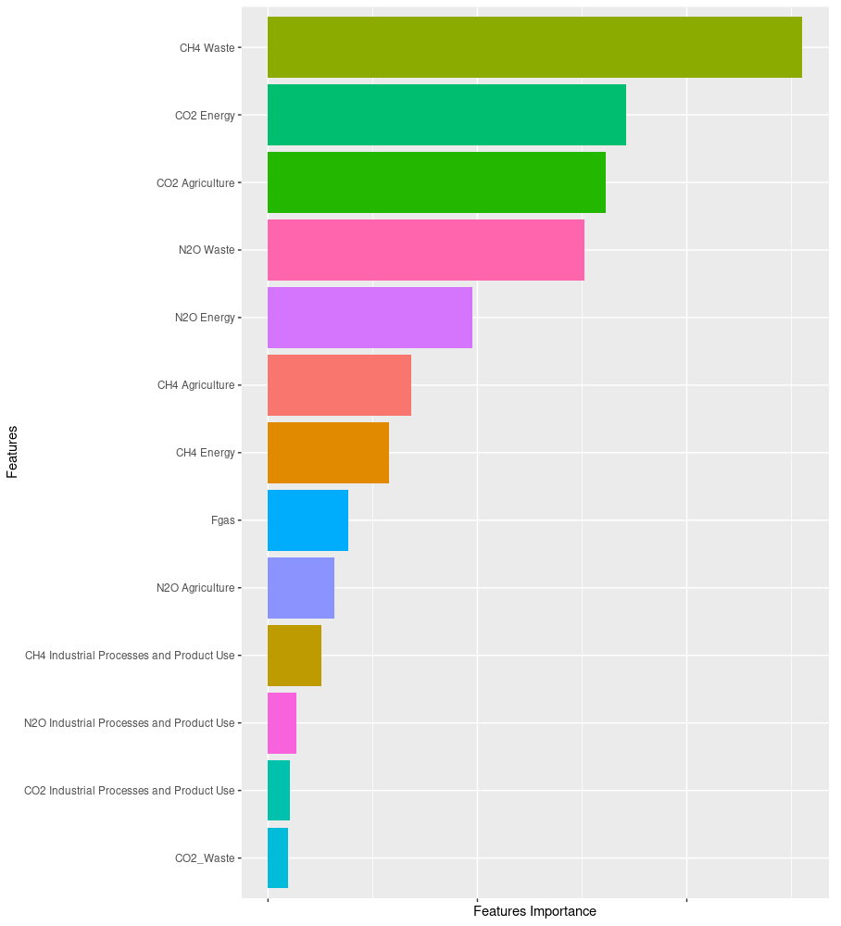
waste
Features Importance from Random Forest Model

Slide 25
Important Features
Waste produced CH4 and N2O
Agriculture produced CO2 and CH4
Energy produced CO2 and N2O

Slide 26
Conclusions
We found that the Industrial Processes and Product Use does not play a very important role on causing Global warming. Part of the reason would be that the huge amount of energy usage was counted separately.
Even though total CO2 emission is relatively larger than all other GHGs, CH4 still play an equality important role.

Slide 27

SUM UP
Americans (especially the people who lives in the middle agriculture States) are not very much be informed with how human is causing climate change
Both CH4 and CO2 are majorly produced from Agriculture
CH4 and CO2 are making critical impact to the global temperature

Slide 28

Recommendations
America, as the world’s largest food producer and exporter, should make some more effort on dealing with climate change.
Spending extra budget on relevant education and broadcasting
Paying extra attention on improving agriculture technology and control its emission would be relatively effective
One easiest way would be stop wasting food, only buy and eat when you need

Slide 29

Thank you

